Slide 1
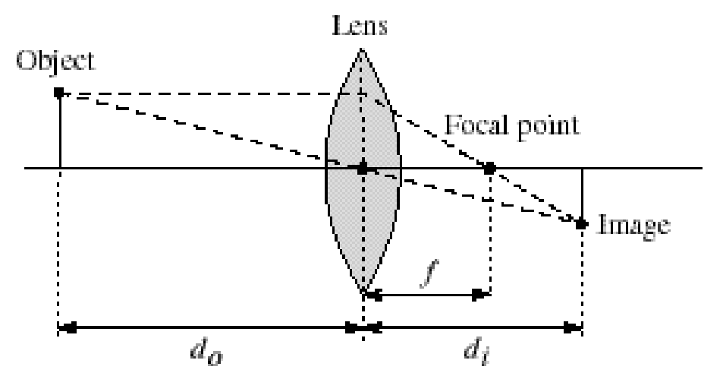
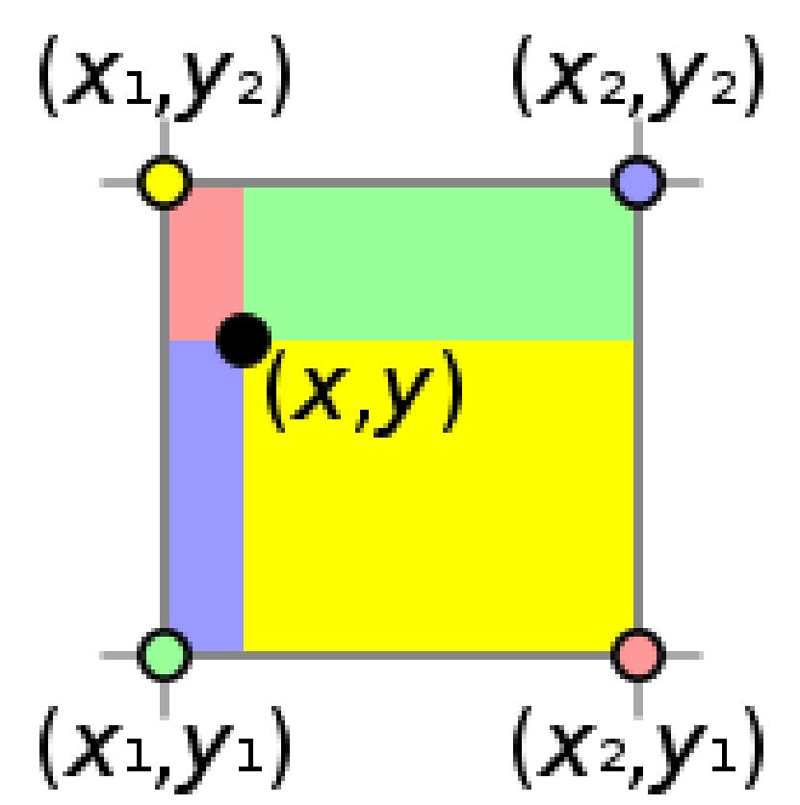
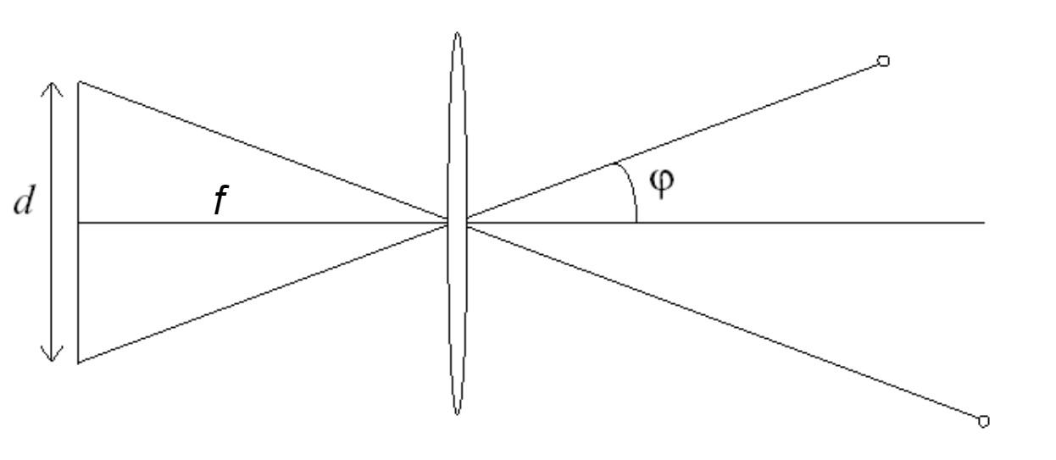
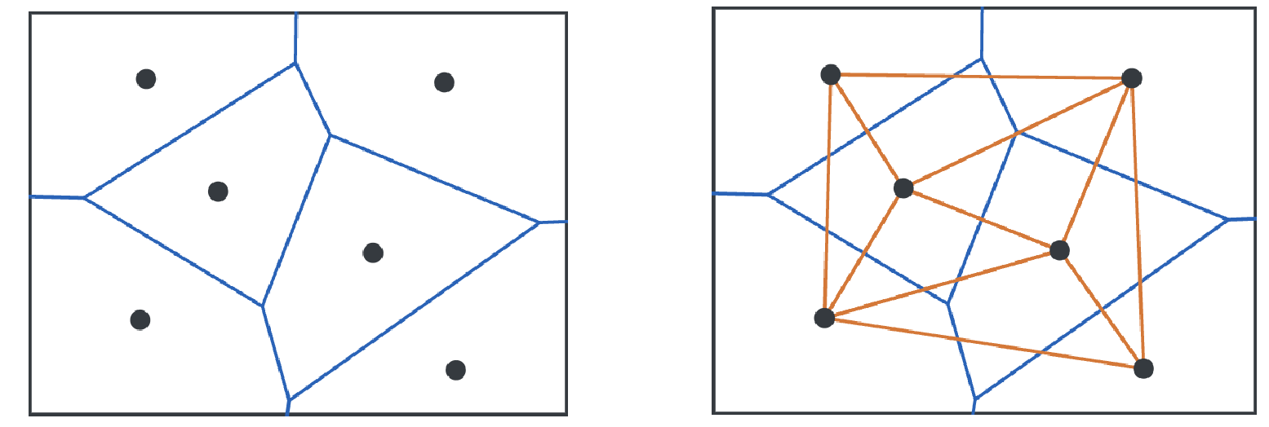
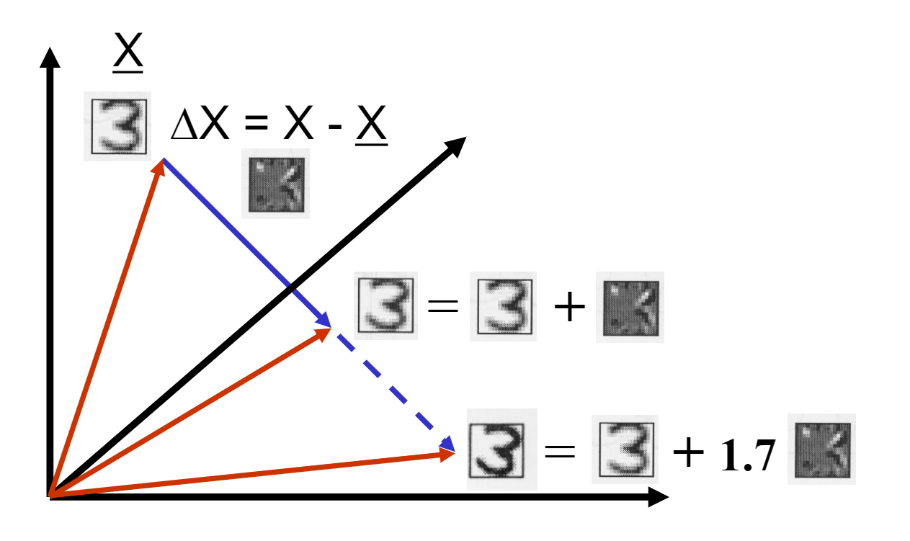
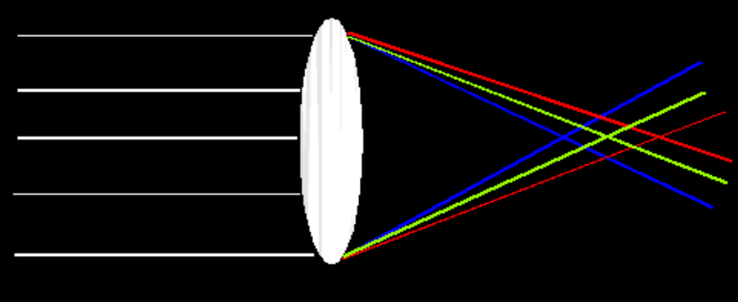
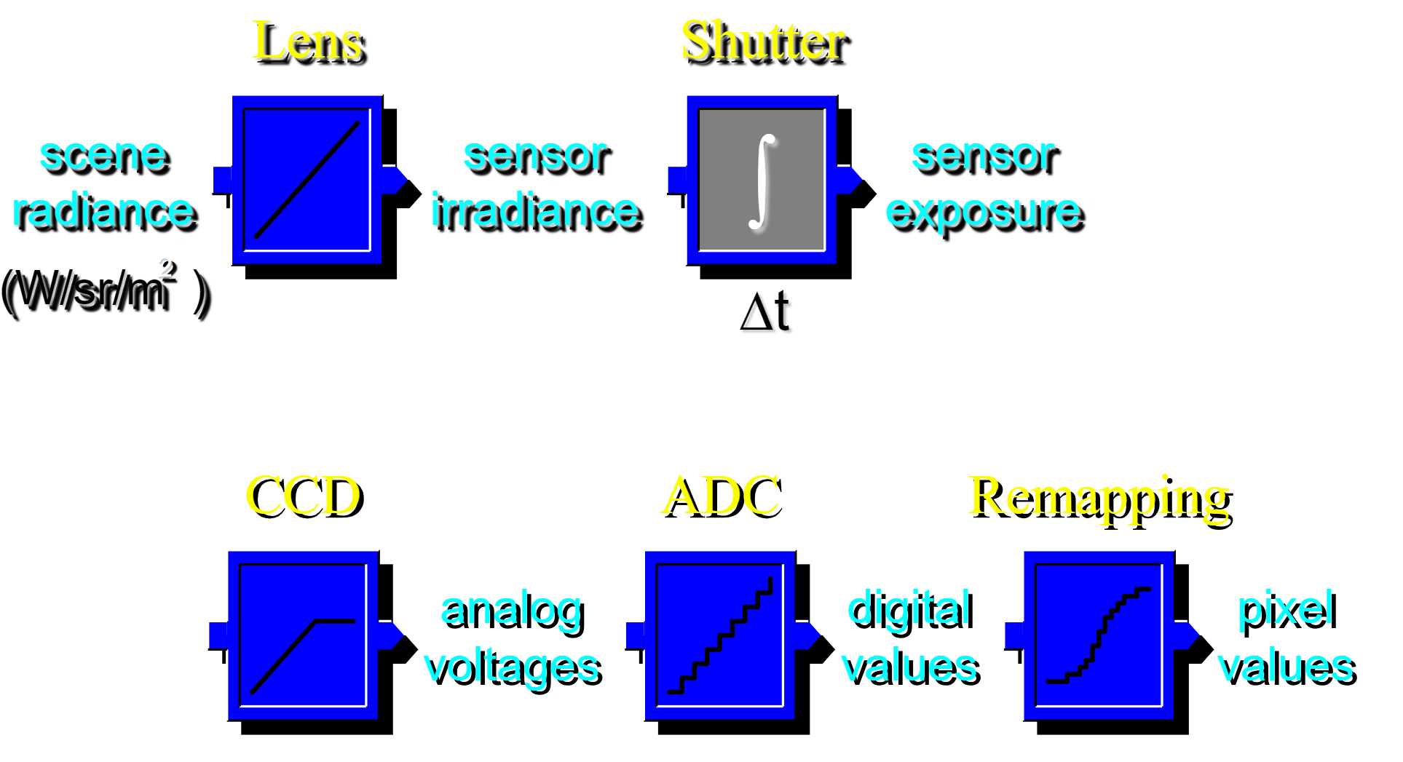
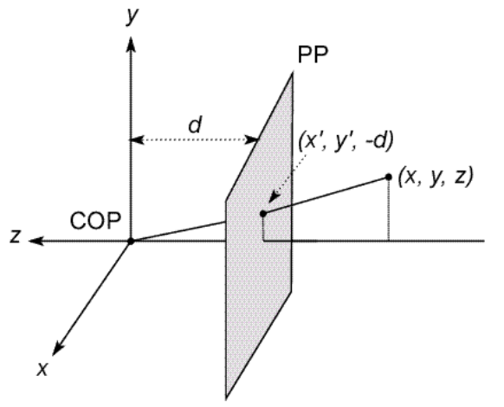
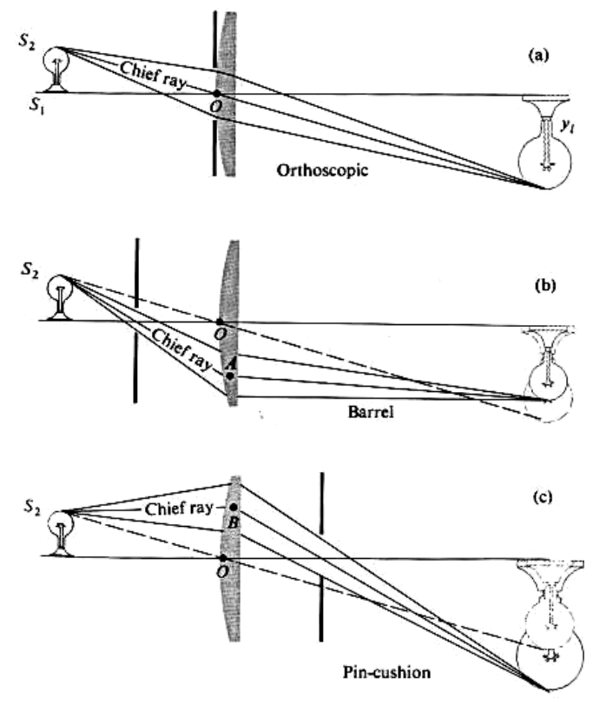
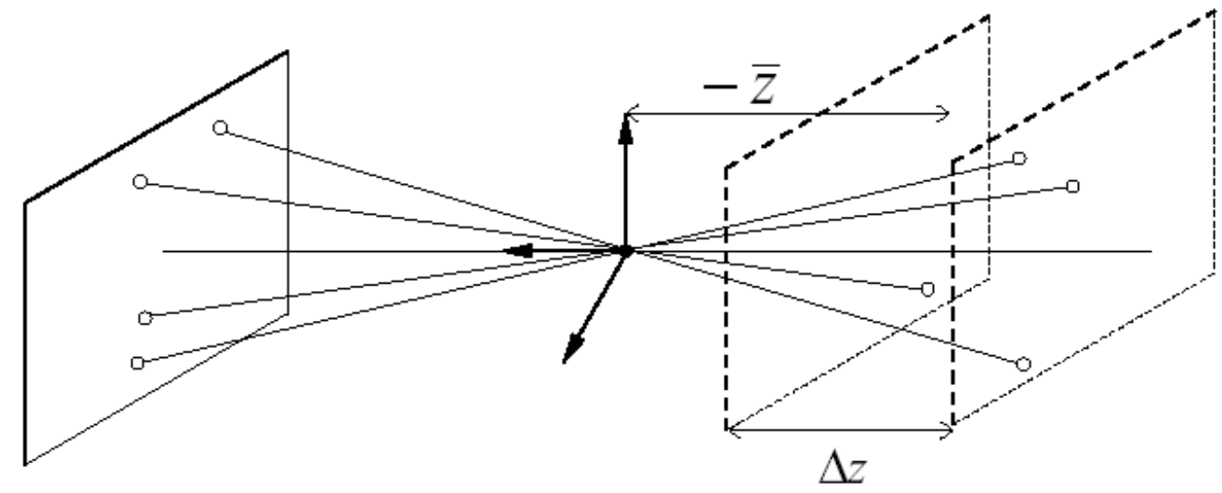
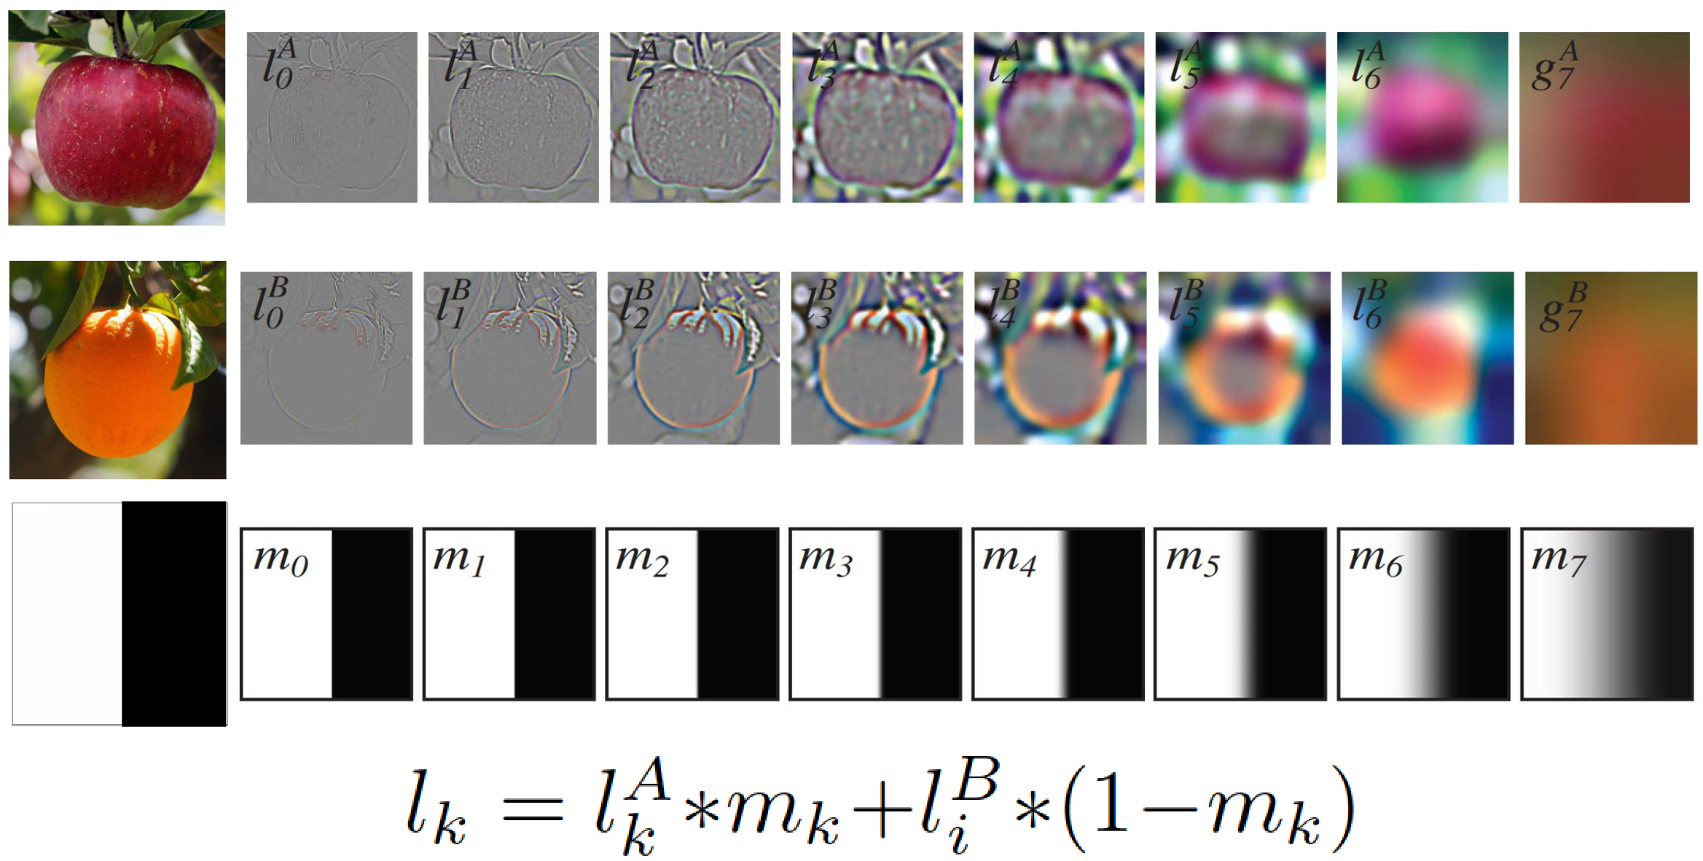
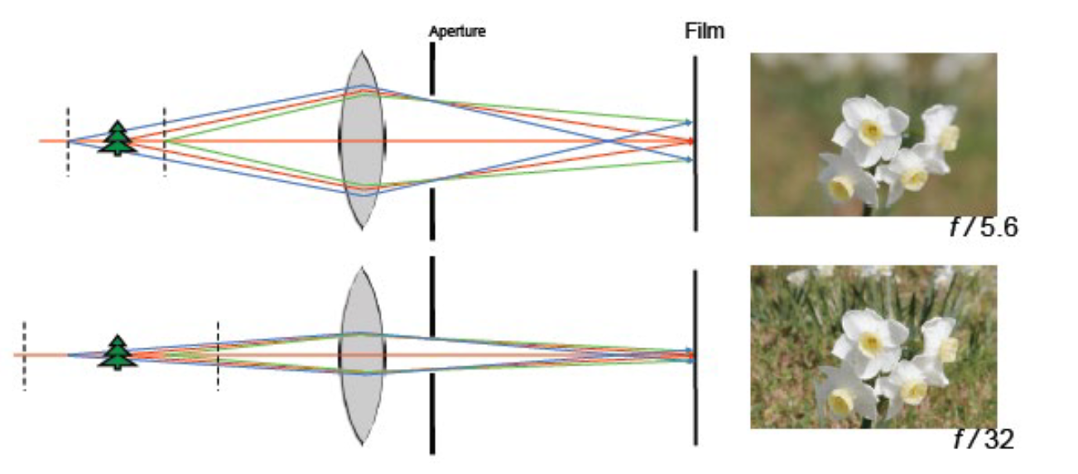
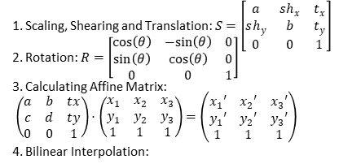

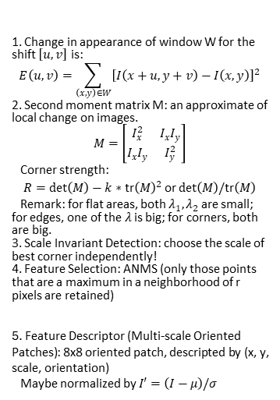
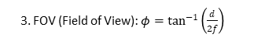
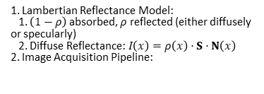
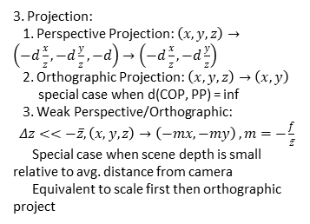

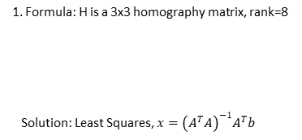

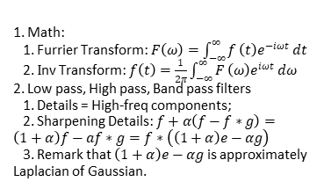
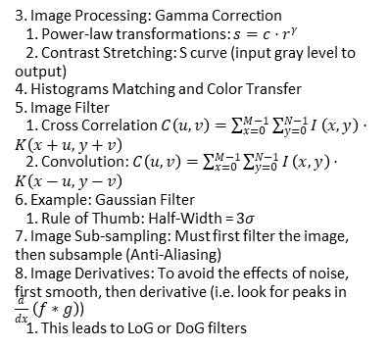
CS180 Final Cheat Sheet
simonxie2004.github.io
Lec 7-9: Affine Transformations
Lec 2: Capturing Light
1. Scaling, Shearing and Translation: $S=\left[\begin{matrix}a & sh_{x} & t_{x} \\ sh_{y} & b & t_{y} \\ 0 & 0 & 1\end{matrix}\right]$
2. Rotation: $R=\left[\begin{matrix}cos\left(θ\right) & −sin\left(θ\right) & 0 \\ sin\left(θ\right) & cos\left(θ\right) & 0 \\ 0 & 0 & 1\end{matrix}\right]$
3. Calculating Affine Matrix:
$\left(\begin{matrix}a & b & tx \\ c & d & ty \\ 0 & 0 & 1\end{matrix}\right)⋅\left(\begin{matrix}x_{1} & x_{2} & x_{3} \\ y_{1} & y_{2} & y_{3} \\ 1 & 1 & 1\end{matrix}\right)=\left(\begin{matrix}x_{1}′ & x_{2}′ & x_{3}′ \\ y_{1}′ & y_{2}′ & y_{3}′ \\ 1 & 1 & 1\end{matrix}\right)$
4. Bilinear Interpolation:
1. Psychophysics of Color:
Mean=Hue; Var=Saturation; Area=Brightness
2. Image Processing Sequence
1. Auto Exposure -> White Balance ->
2. -> Contrast -> Gamma
3. White Balancing Algorithms
1. Grey World: force avg.color of scene to grey
2. White World: force brightest object to white
4. Quad Bayer Filters
1. Why more green pixels? Because human are most sensitive to green light.
5. Color Spaces: RGB, CMY(K), HSV,
L*a*b* (Perceptually uniform color space)
6. Image similarity:
1. SSD, i.e. L2 Distance
2. NCC, invariant to local avg and contrast
3. FOV (Field of View): $φ=\tan^{−1}\left(\frac{d}{2f}\right)$
5. Delaunay Triangulation:
Dual graph of Voroni Diagram
6. Morphing and Extrapolation
4. Exposure & Shutter Speed
Example: F5.6+1/30Sec = F11+1/8Sec
5. Lens Flaws
1. Chromatic Aberration: Due to wavelength-dependent refractive index, modifies ray-bending and focal length
Lec 3-4: Pixels and Images
1. Lambertian Reflectance Model:
1. $\left(1−ρ\right)$ absorbed, $ρ$ reflected (either diffusely or specularly)
2. Diffuse Reflectance: $I\left(x\right)=ρ\left(x\right)⋅S⋅N\left(x\right)$
2. Image Acquisition Pipeline:
Lec 10: Cameras
1. Pinhole camera model
1. Defines Center of Projection and Image Plane
2. Defines Effective Focal Length as d
2. Camera coordinate systems
2. Radial Distortion: Normal, Barrel, Pin-cushion
3. Image Processing: Gamma Correction
1. Power-law transformations: $s=c⋅r^{γ}$
2. Contrast Stretching: S curve (input gray level to output)
4. Histograms Matching and Color Transfer
5. Image Filter
1. Cross Correlation $C\left(u,v\right)=\sum_{x=0}^{M−1}{\sum_{y=0}^{N−1}{I}}\left(x,y\right)⋅K\left(x+u,y+v\right)$
2. Convolution: $C\left(u,v\right)=\sum_{x=0}^{M−1}{\sum_{y=0}^{N−1}{I}}\left(x,y\right)⋅K\left(x−u,y−v\right)$
6. Example: Gaussian Filter
1. Rule of Thumb: Half-Width = $3σ$
7. Image Sub-sampling: Must first filter the image, then subsample (Anti-Aliasing)
8. Image Derivatives: To avoid the effects of noise, first smooth, then derivative (i.e. look for peaks in $\frac{d}{dx}\left(f∗g\right)$)
1. This leads to LoG or DoG filters
Supp: Vector Cross Product
$$\left[a_{x}\right]=\left[\begin{matrix}0 & −a_{z} & a_{y} \\ a_{z} & 0 & −a_{x} \\ −a_{y} & a_{x} & 0\end{matrix}\right]$$
3. Projection:
1. Perspective Projection: $\left(x,y,z\right)→\left(−d\frac{x}{z},−d\frac{y}{z},−d\right)→\left(−d\frac{x}{z},−d\frac{y}{z}\right)$
2. Orthographic Projection: $\left(x,y,z\right)→\left(x,y\right)$
special case when d(COP, PP) = inf
3. Weak Perspective/Orthographic:
$Δz<<−\overset{‾}{z},\left(x,y,z\right)→\left(−mx,−my\right)$ $, m=−\frac{f}{\overset{‾}{z}}$
Special case when scene depth is small relative to avg. distance from camera
Equivalent to scale first then orthographic project
Lec 11: Perspective Transforms
1. Formula: H is a 3x3 homography matrix, rank=8
Solution: Least Squares, $x={\left(A^{T}A\right)}^{−1}A^{T}b$
Lec 5: Furrier Transform
1. Math:
1. Furrier Transform: $F\left(ω\right)=\int_{−∞}^{∞}{f}\left(t\right)e^{−iωt} dt$
2. $I$nv Transform: $f\left(t\right)=\frac{1}{2π}\int_{−∞}^{∞}{F}\left(ω\right)e^{iωt} dω$
2. Low pass, High pass, Band pass filters
1. Details = High-freq components;
2. Sharpening Details: $f+α\left(f−f∗g\right)=\left(1+α\right)f−af∗g=f∗\left(\left(1+α\right)e−αg\right)$
3. Remark that $\left(1+α\right)e−αg$ is approximately Laplacian of Gaussian.
Lec 12-14: Feature Extraction
1. Change in appearance of window W for the shift $\left[u,v\right]$ is:
$$E\left(u,v\right)=\sum_{\left(x,y\right)∈W}^{​}{{\left[I\left(x+u,y+v\right)−I\left(x,y\right)\right]}^{2}}$$
2. Second moment matrix M: an approximate of local change on images.
$$M=\left[\begin{matrix}I_{x}^{2} & I_{x}I_{y} \\ I_{x}I_{y} & I_{y}^{2}\end{matrix}\right]$$
Corner strength:
$$R=det\left(M\right)−k∗\text{tr}{\left(M\right)}^{2} \text{or} det\left(M\right)/\text{tr}\left(M\right)$$
Remark: for flat areas, both $λ_{1},λ_{2}$ are small; for edges, one of the $λ$ is big; for corners, both are big.
3. Scale Invariant Detection: choose the scale of best corner independently!
4. Feature Selection: ANMS (only those points that are a maximum in a neighborhood of r pixels are retained)
5. Feature Descriptor (Multi-scale Oriented Patches): 8x8 oriented patch, descripted by (x, y, scale, orientation)
Maybe normalized by $I′=\left(I−μ\right)/σ$
Lec 6: Pyramids Blending
4. Spherical Projection: $\left(θ,φ\right)→\left(θ,φ,d\right)$
4. Camera Parameters
1. Aperture: Bigger aperture = Shallower scene depth, Narrower gate width
1. Gaussian Pyramids and Laplacian Pyramids (Remember to add lowest freq!)
--- Some other image algorithms ---
2. Denoising: Median Filter
3. Lossless Compression (PNG): Huffman Coding
4. Lossy Compression (JPEG): Block-based Discrete Cosine Transform (DCT)
Compute DCT Coefficients; Coarsely Quantize;
Encode (e.g. with Huffman Coding)
2. Thin Lenses: $\frac{1}{d_{o}}+\frac{1}{d_{i}}=\frac{1}{f}$

Slide 2
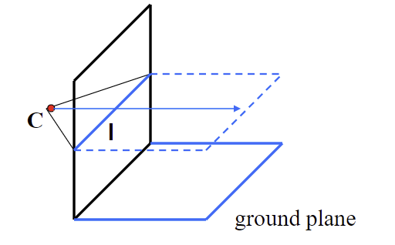
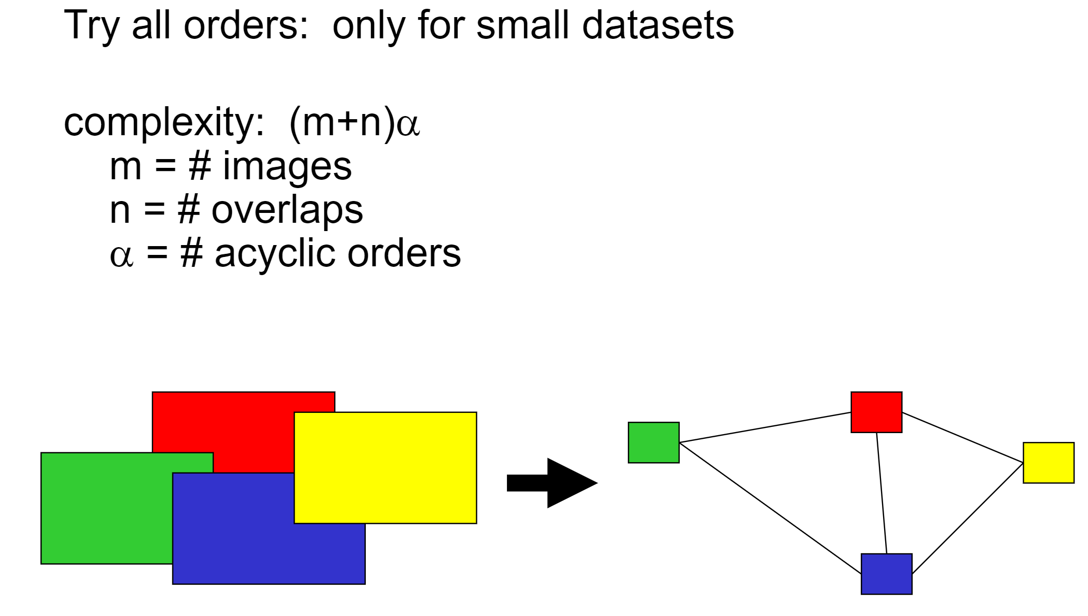
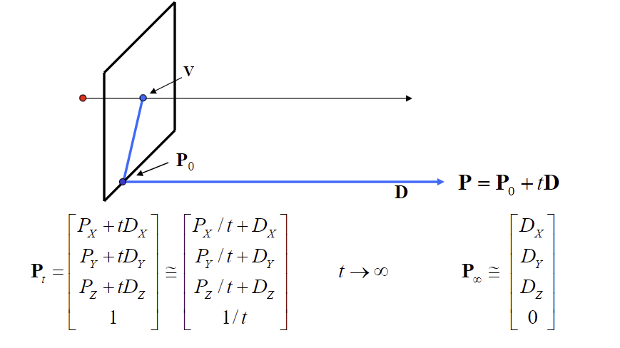
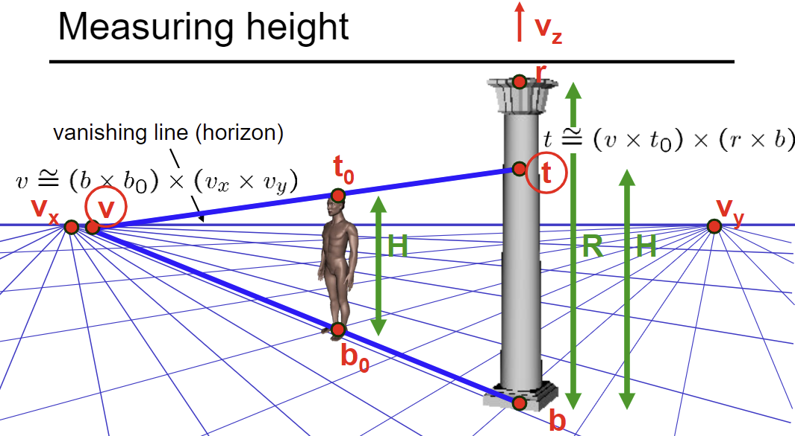
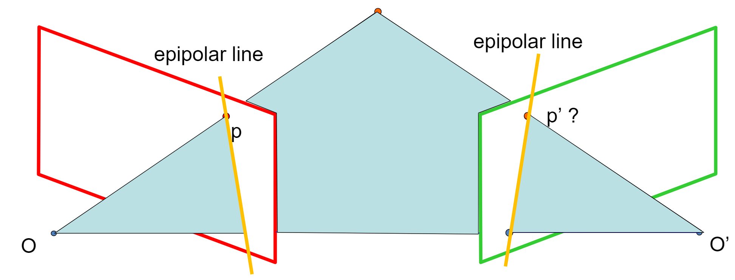
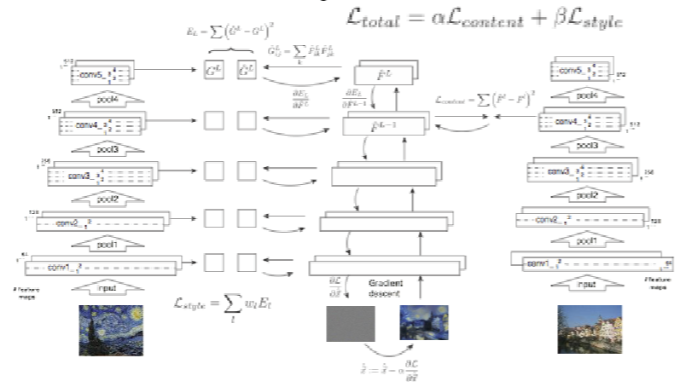
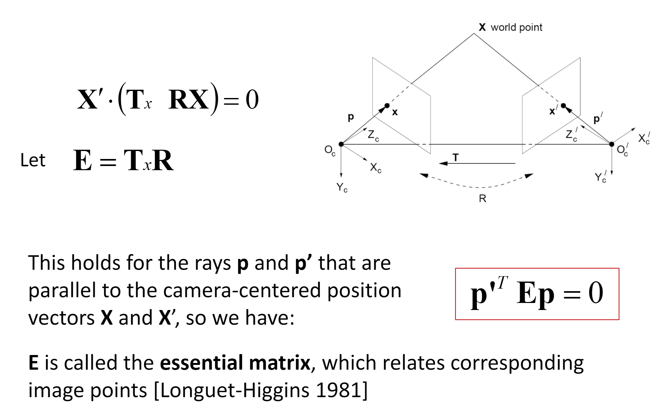
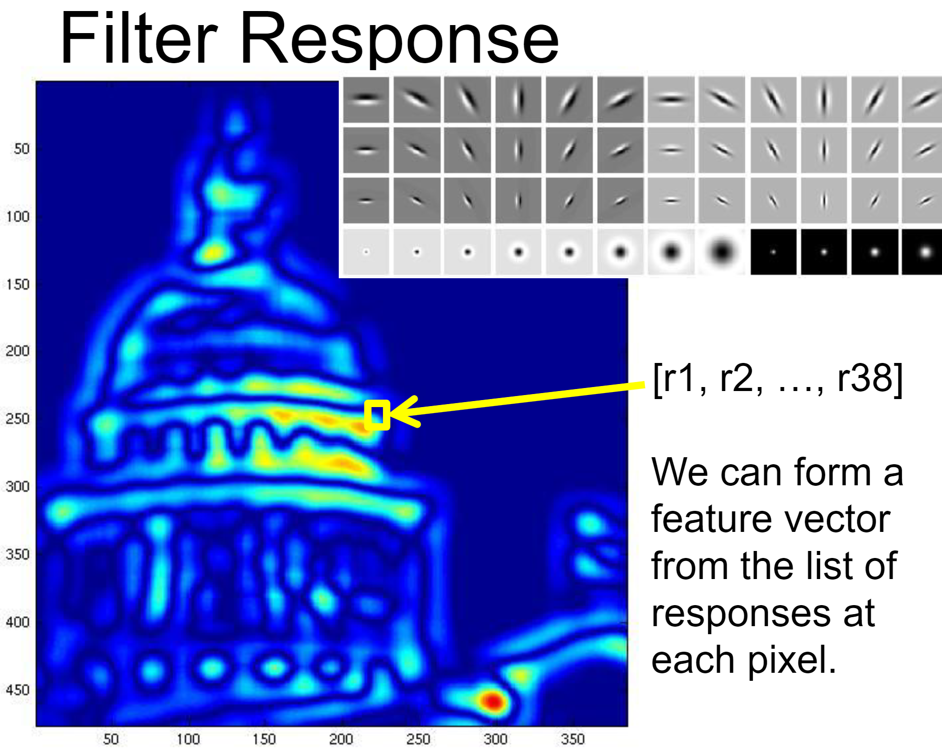
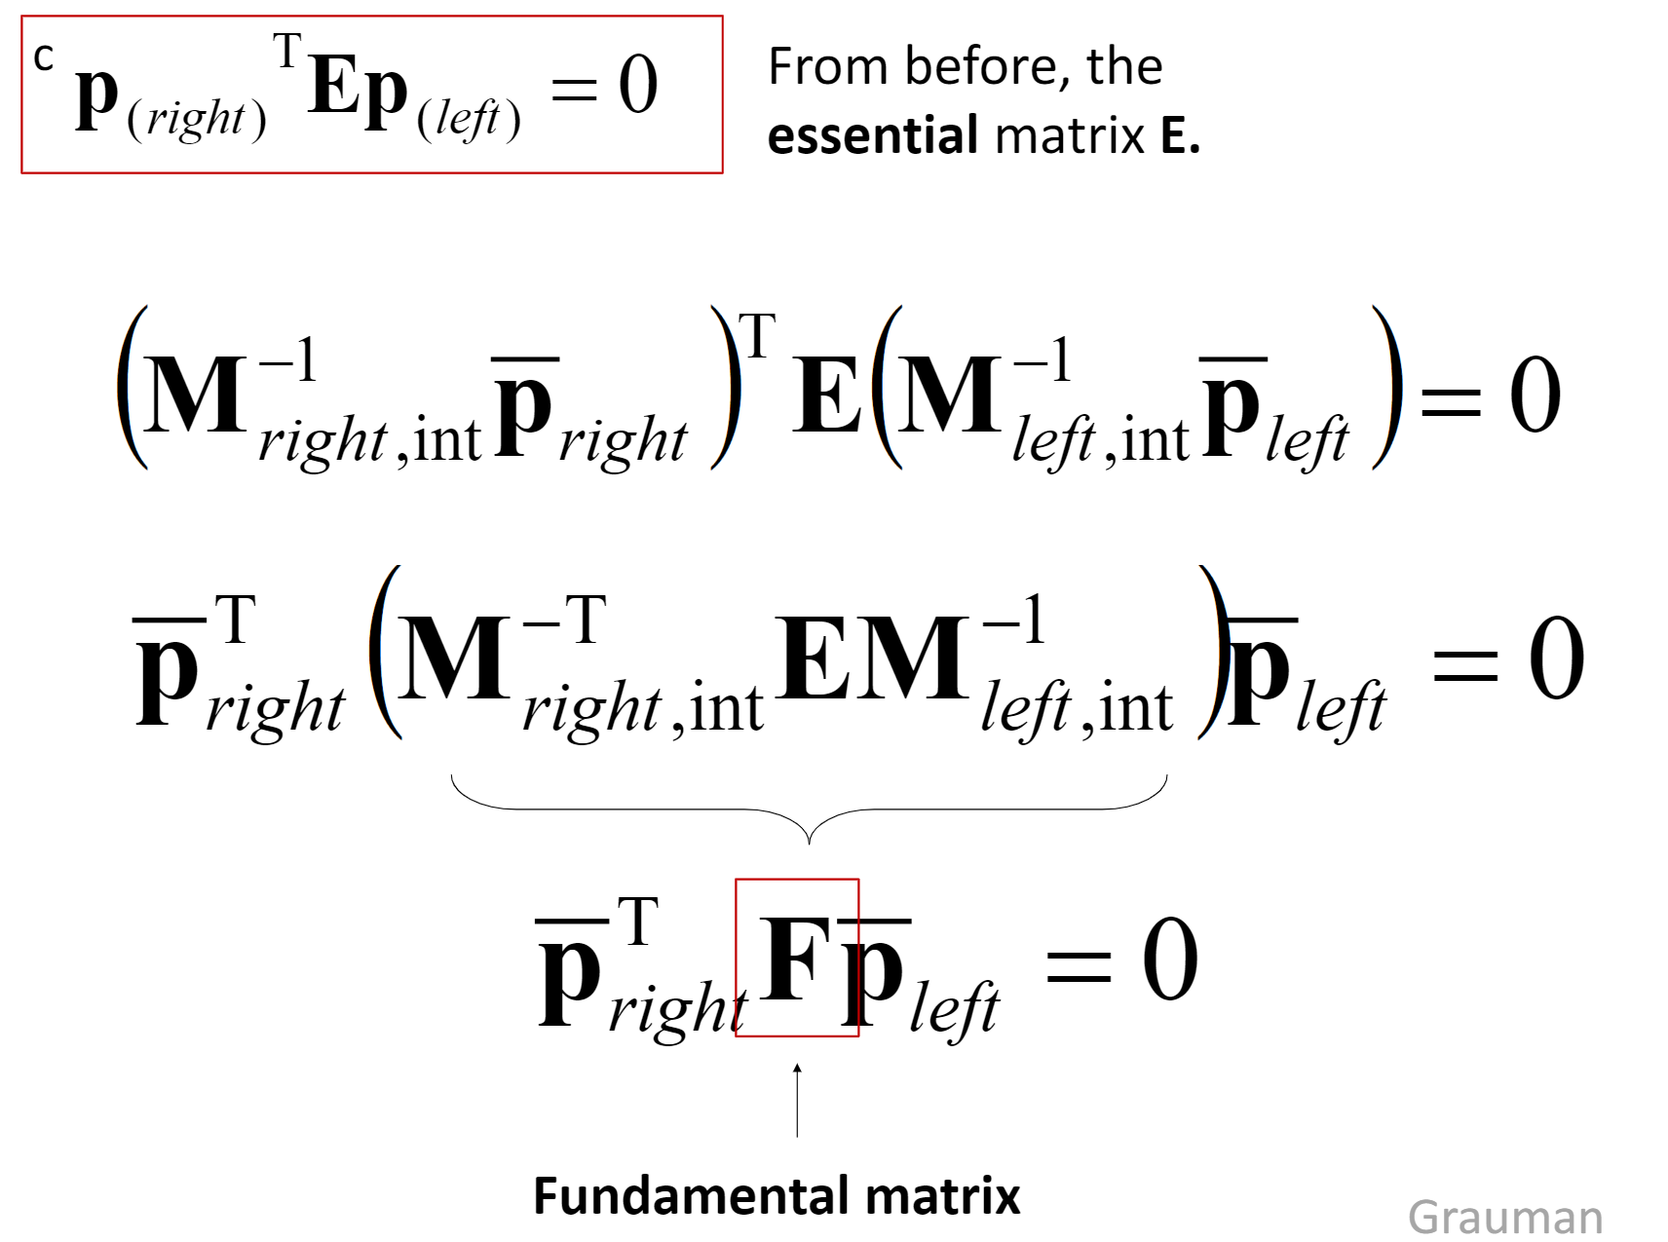
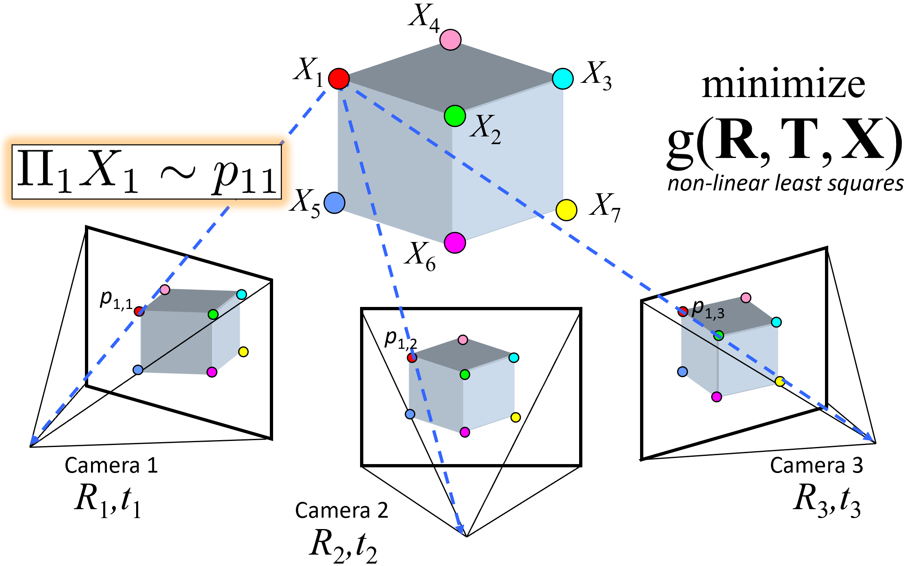
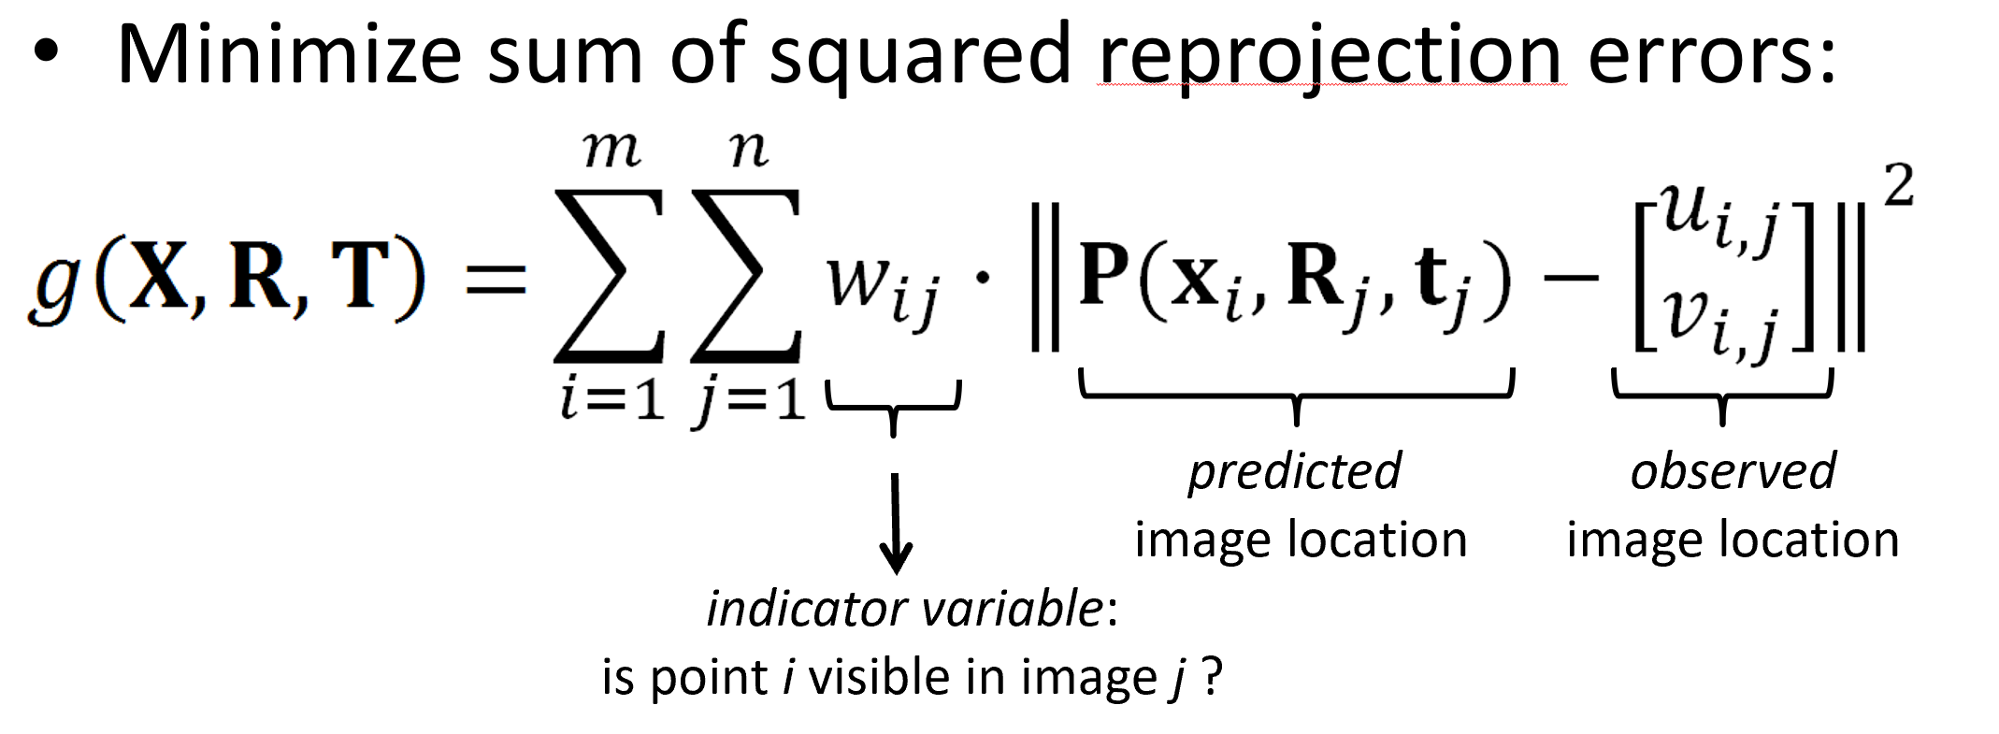
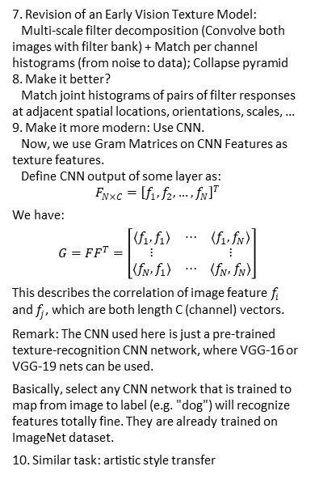
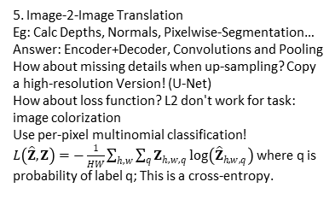
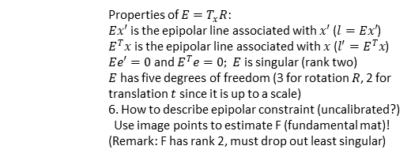
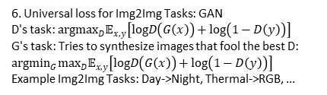
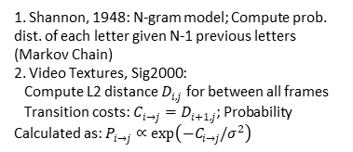
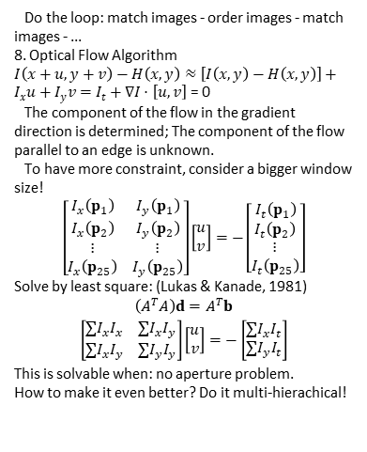
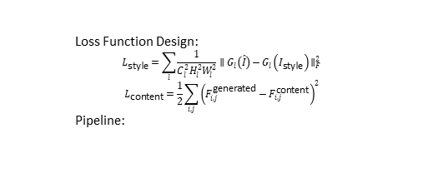
6. Matching Feature:
Step 1: Lowe's Trick, match(1-NN) - match(2-NN)
Step 2: RANSAC (random choose 4 points; calc homography; calc outliers; finally select best homography)
7. Further Techniques: Order images to reduce inconsistencies
6. Universal loss for Img2Img Tasks: GAN
D's task: $arg\max_{D}𝔼_{x,y}\left[logD\left(G\left(x\right)\right)+log\left(1−D\left(y\right)\right)\right]$
G's task: Tries to synthesize images that fool the best D: $arg\min_{G}\max_{D}𝔼_{x,y}\left[logD\left(G\left(x\right)\right)+log\left(1−D\left(y\right)\right)\right]$
Example Img2Img Tasks: Day->Night, Thermal->RGB, ...
Lec 20-21: 3D Vision Geometry
1. A vanishing line in the image correspond to a plane of rays through origin.
An image may have more than one vanishing point.
The union of all vanishing points is the horizon line.
7. Revision of an Early Vision Texture Model:
Multi-scale filter decomposition (Convolve both images with filter bank) + Match per channel histograms (from noise to data); Collapse pyramid
8. Make it better?
Match joint histograms of pairs of filter responses at adjacent spatial locations, orientations, scales, ...
9. Make it more modern: Use CNN.
Now, we use Gram Matrices on CNN Features as texture features.
Define CNN output of some layer as:
$$F_{N×C}={\left[f_{1},f_{2},…,f_{N}\right]}^{T}$$
We have:
$$G=FF^{T}=\left[\begin{matrix}⟨f_{1},f_{1}⟩ & ⋯ & ⟨f_{1},f_{N}⟩ \\ ⋮ & & ⋮ \\ ⟨f_{N},f_{1}⟩ & ⋯ & ⟨f_{N},f_{N}⟩\end{matrix}\right]$$
This describes the correlation of image feature $f_{i}$ and $f_{j}$, which are both length C (channel) vectors.
Remark: The CNN used here is just a pre-trained texture-recognition CNN network, where VGG-16 or VGG-19 nets can be used.
Basically, select any CNN network that is trained to map from image to label (e.g. "dog") will recognize features totally fine. They are already trained on ImageNet dataset.
10. Similar task: artistic style transfer
Do the loop: match images - order images - match images - ...
8. Optical Flow Algorithm
$I\left(x+u,y+v\right)−H\left(x,y\right)≈\left[I\left(x,y\right)−H\left(x,y\right)\right]+I_{x}u+I_{y}v=I_{t}+∇I⋅\left[u,v\right]$ = 0
The component of the flow in the gradient direction is determined; The component of the flow parallel to an edge is unknown.
To have more constraint, consider a bigger window size!
$$\left[\begin{matrix}I_{x}\left(p_{1}\right) & I_{y}\left(p_{1}\right) \\ I_{x}\left(p_{2}\right) & I_{y}\left(p_{2}\right) \\ ⋮ & ⋮ \\ I_{x}\left(p_{25}\right) & I_{y}\left(p_{25}\right)\end{matrix}\right]\left[\begin{matrix}u \\ v\end{matrix}\right]=−\left[\begin{matrix}I_{t}\left(p_{1}\right) \\ I_{t}\left(p_{2}\right) \\ ⋮ \\ I_{t}\left(p_{25}\right)\end{matrix}\right]$$
Solve by least square: (Lukas & Kanade, 1981)
$$\left(A^{T}A\right)d=A^{T}b$$
$$\left[\begin{matrix}∑I_{x}I_{x} & ∑I_{x}I_{y} \\ ∑I_{x}I_{y} & ∑I_{y}I_{y}\end{matrix}\right]\left[\begin{matrix}u \\ v\end{matrix}\right]=−\left[\begin{matrix}∑I_{x}I_{t} \\ ∑I_{y}I_{t}\end{matrix}\right]$$
This is solvable when: no aperture problem.
How to make it even better? Do it multi-hierachical!
2. Measuring Height in 3D:
3. Calibrating Camera: Learning Problem, just like solving homography.
4. Epipolar geometry
Baseline: the line connecting the two camera centers
Epipole: point of intersection of baseline with the image plane
Epipolar plane: the plane that contains the two camera centers and a 3D point in the world
Epipolar line: intersection of the epipolar plane with each image plane
Loss Function Design:
$$L_{\text{style}}=\sum_{l}^{​}{\frac{1}{C_{l}^{2}H_{l}^{2}W_{l}^{2}}}∥G_{l}\left(\hat{I}\right)−G_{l}\left(I_{\text{style}}\right)∥_{F}^{2}$$
$$L_{\text{content}}=\frac{1}{2}\sum_{i,j}^{​}{{\left(F_{i,j}^{\text{generated}}−F_{i,j}^{\text{content}}\right)}^{2}}$$
Pipeline:
Lec 15-16: Texture Models
Usage: Stereo image rectification
Reproject image planes onto a common plane parallel to the line between optical centers
Then pixel motion is horizontal after transformation
Two homographies (3x3 transforms), one for each input image reprojection
5. How to describe epipolar constraint (calibrated)?
1. Human vision patterns
1. Pre-attentive vision: parallel (~100-200ms)
2. Attentive vision: serial search (~50ms)
2. Order statistics of Textures:
1. First order: mean, var, std, ...
2. Second order: co-occurence matrix, contrast, ...
3. Introduction: Cells in Retina
1. Receptive field of a retinal ganglion cell can be modeled as a LoG filter. (Corner Detectors)
2. Cortical Receptive Fields -> (Line/Edge Detectors)
3. They are connected just like a CNN network.
4. From Cells to Image Filters: [Filter Banks]
1. Detects Statistical unit of texture (texton) in real images: from object to bag of “words”
2. Usage: hist matching of words -> object classify
Lec 17-18: Diffusion Models
1. Sampling Methods: DDPM v.s. DDIM
2. Make Sampling Faster: Train a “distilled” network
3. Edit desired area: Genearte a Mask that a word correspond to.
Common Image Generating Models:
Parti: self-regressive model; generates block by block
Imagen: Diffusion; Dalle-2: Parti + Imagen
Properties of $E=T_{x}R$:
$Ex′$ is the epipolar line associated with $x′$ ($l=Ex′$)
$E^{T}x$ is the epipolar line associated with $x$ ($l′=E^{T}x$) $Ee′=0$ and $E^{T}e=0; E$ is singular (rank two)
$E$ has five degrees of freedom (3 for rotation $R$, 2 for translation $t$ since it is up to a scale)
6. How to describe epipolar constraint (uncalibrated?)
Use image points to estimate F (fundamental mat)!
(Remark: F has rank 2, must drop out least singular)
Lec 19: Sequence Models
1. Shannon, 1948: N-gram model; Compute prob. dist. of each letter given N-1 previous letters (Markov Chain)
2. Video Textures, Sig2000:
Compute L2 distance $D_{i,j}$ for between all frames
Transition costs: $C_{i→j}=D_{i+1,j}$; Probability Calculated as: $P_{i→j}∝exp\left(−C_{i→j}/σ^{2}\right)$
5. Image-2-Image Translation
Eg: Calc Depths, Normals, Pixelwise-Segmentation… Answer: Encoder+Decoder, Convolutions and Pooling
How about missing details when up-sampling? Copy a high-resolution Version! (U-Net)
How about loss function? L2 don't work for task: image colorization
Use per-pixel multinomial classification!
$L\left(\hat{Z},Z\right)=−\frac{1}{HW}\sum_{h,w}^{​}{\sum_{q}^{​}{Z_{h,w,q}}}log\left({\hat{Z}}_{h,w,q}\right)$ where q is probability of label q; This is a cross-entropy.
3. Image Analogies Algorithm: Process an image by example (A:A' :: B:B') (Siggraph 2001)
Compare area of pixels (e.g. 10*10) from imgA and B.
Find the best match, then copy some smaller area of pixels (e.g. 3*3) from imgA' to imgB’
Remark: New method use VQGAN and MAE.
4. Word Embedding (word2Vec, GloVe)...
Attention + Prediction: Word sequence tasks
possible explanation: different layers (attention+prediction) works for different functions (syntax, semantics, ...)
Lec 22: SFM
1. Bundle
Adjustment
Problem:

